Slide 2

#1
Do you prefer
Online Shopping ?
1. Yes 2. No

Slide 3

What are the issues ?
#3

Slide 4
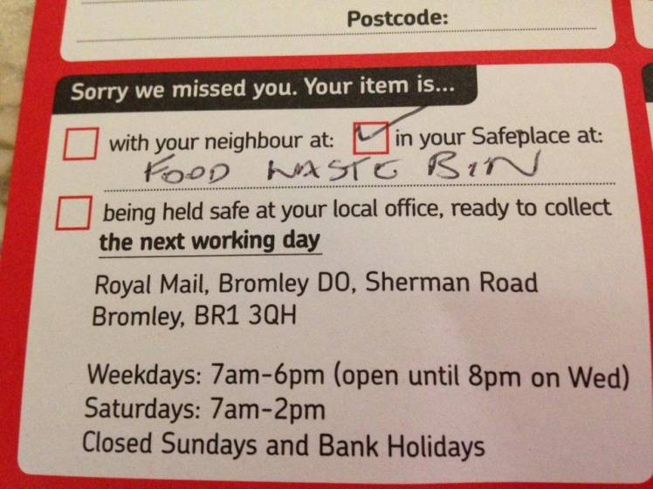

#4

Slide 5

Q-Trace
Smart Parcel Tracking Service

Slide 6

#14
What we provide ?
Smart and Reliable Tracking Service
Dynamic Destination Address Service
Better user experience
Seller ←→ Delivery Service
Delivery Service ←→ Buyer
Seller ←→ Buyer

Slide 7

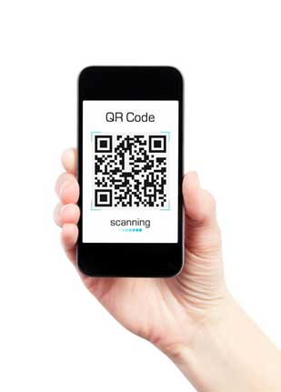

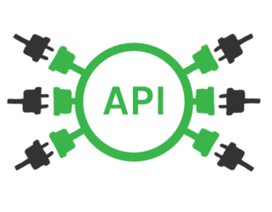
#14
APIs for seller
Mobile App for
Delivery Service
Web App for Buyers

Slide 8

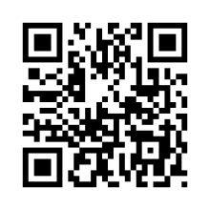
#14
How Reliable Tracking happens ?
Seller can create QR code stamps using our APIs and stick them on the parcel
Receiver’s Name
House Number,
Street,
Town
ABC-12345678-D

Slide 9
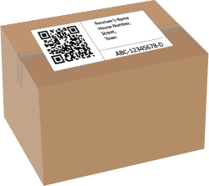
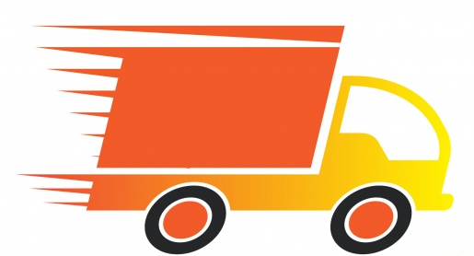
#14
How Reliable Tracking happens ?
Seller can create QR code stamp using our APIs.
Delivery service can scan the QR code using our App at each parcel exchange.

Slide 10

#14
How Reliable Tracking happens ?
Seller can create QR code stamp using our APIs.
Delivery service can scan the QR code using our App at each parcel exchange.
Delivery agents can be tracked using GPS.

Slide 11
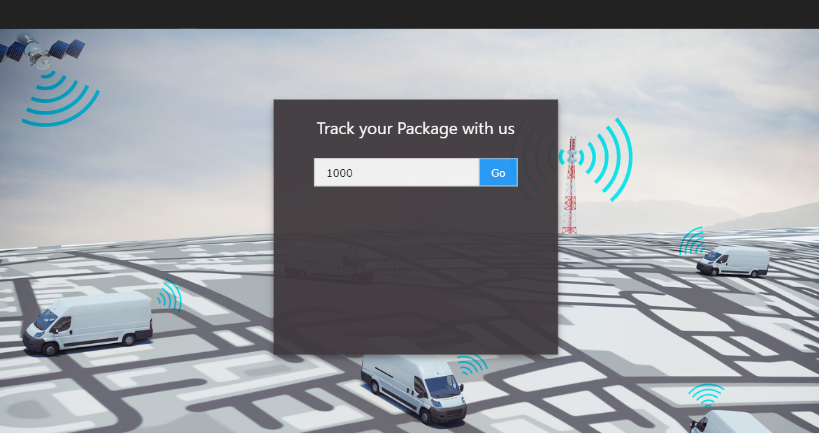
#14
How Reliable Tracking happens ?
Seller can create QR code stamp using our APIs.
Delivery service can scan the QR code using our App at each parcel exchange.
Delivery agents can be tracked using GPS.
Buyers can track their parcels using our Web App
ABC-12345678-D

Slide 12
#14
Dynamic Destination Address Service
Example
You give your home address as Delivers Address.
You know you will receive the parcel today, but today you’re not in home.
You can update your pickup place* as your workplace
or
ask to hold the parcel for that day.

Slide 13

How revenue generates ?
API Market
We will release our platform as Web APIs. (Application Programming Interface)
Any selling, delivery company can register with these APIs and take the advantages of our platform.
Charging per number of API requests.
Technical support
We can provide technical support to these companies.
Integrate our platform with mobile apps, websites etc…

Slide 14


Slide 15


Slide 17

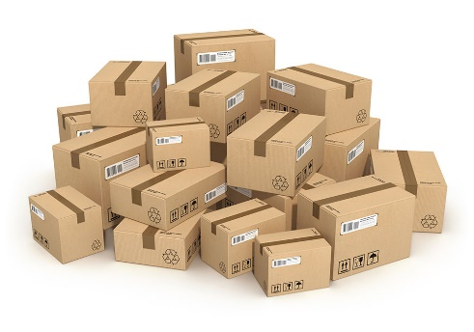



Index
#17
#18
#19
#20

Slide 18


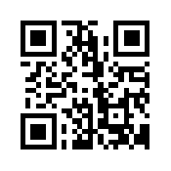

#17

Slide 19

Feature Improvements
#18
Dynamic Destination Addresses
Clients can change their address while the parcel/package in delivery
Can add rules for the destination address
Provide Cash on Delivery Service
The client can pay using his/her bank account through the app.
The mobile app can analyze its previous data and correctly estimate a high precision delivery time from one location to other.
GPS enabled tracking device for delivery vehicles.

Slide 20




Technologies will be used
#19
HTML, JavaScript (jQuery) & CSS for frontend development
PHP, MySQL for backend development
HTTP Restful APIs (JSON)
Apache Cordova for Mobile App Development
(Supports hybrid mobile app development; Android, Windows & iOS )

Slide 21
What will be done in the Hackathon?
#20
Develop the essential platform futures
qTrace Deliver App
qTrace Parcel Tracking Site
IoT based tracking device

Slide 22
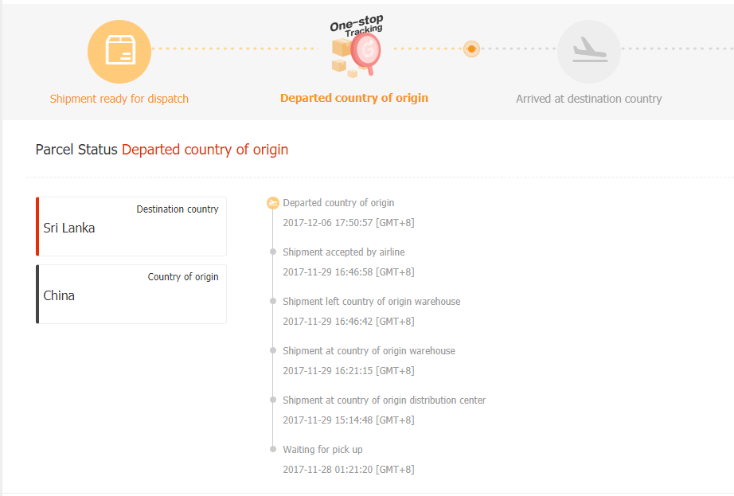
#21

Slide 23
#14
What are the advantages ?
Reliability
- Always there is a person with responsibility.
- Can avoid parcel lost.
Transparent service for both sellers and buyers
Dynamic Destination Address
- Buyer can update their location while the parcel in delivery.*
No additional hardware requirements – Easy to setup

